Slide 1
A Hundredfold Brothers and Sisters

Slide 2
Mark 10:29-30
²⁹ Jesus said, “Truly, I say to you, there is no one who has left house or brothers or sisters or mother or father or children or lands, for my sake and for the gospel, ³⁰ who will not receive a hundredfold now in this time, houses and brothers and sisters and mothers and children and lands, with persecutions, and in the age to come eternal life.

Slide 3
A Journey of Emotions
A Quick Map Review

Slide 4
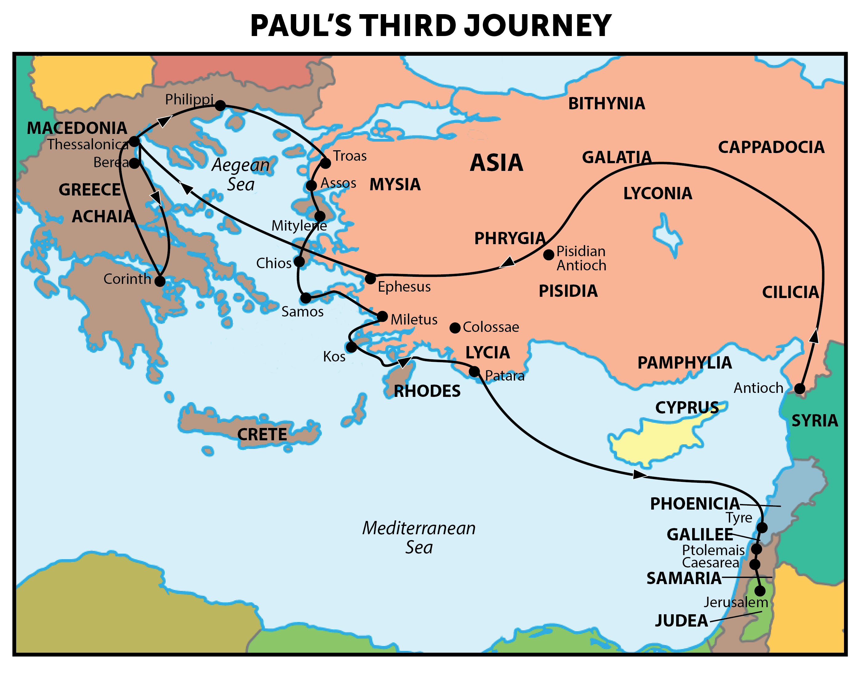
2
4
3
1
5
A Journey of Emotion

Slide 5
5
A Journey of Emotion
6
7
8
9

Slide 6
A Journey of Emotions
Macedonia (Philippi and Thess.) – Acts 20:2
Greece (Acaia) – Acts 20:3
Troas – Acts 20:6-12
Miletus (Ephesian elders) – Acts 20:17-38
Tyre – Acts 21:3-7
Ptolemais – Acts 21:7
Caesarea – Acts 21:8-14
House of Mnason – Acts 21:16
Jerusalem – Acts 21:17-20a

Slide 7
A Tale of Two Churches
For I want you to know how great a struggle I have for you and for those at Laodicea and for all who have not seen me face to face, ² that their hearts may be encouraged, being knit together in love, to reach all the riches of full assurance of understanding and the knowledge of God's mystery, which is Christ, ³ in whom are hidden all the treasures of wisdom and knowledge . . .
⁵ For though I am absent in body, yet I am with you in spirit, rejoicing to see your good order and the firmness of your faith in Christ – Colossians 2:1-3, 5

Slide 8
A Tale of Two Churches
¹⁷ But since we were torn away from you, brothers, for a short time, in person not in heart, we endeavored the more eagerly and with great desire to see you face to face, ¹⁸ because we wanted to come to you—I, Paul, again and again—but Satan hindered us. ¹⁹ For what is our hope or joy or crown of boasting before our Lord Jesus at his coming? Is it not you? ²⁰ For you are our glory and joy – I Thessalonians 2:17-20

Slide 9
A Tale of Two Churches
⁶ But now that Timothy has come to us from you, and has brought us the good news of your faith and love and reported that you always remember us kindly and long to see us, as we long to see you— ⁷ for this reason, brothers, in all our distress and affliction we have been comforted about you through your faith. ⁸ For now we live, if you are standing fast in the Lord. ⁹ For what thanksgiving can we return to God for you, for all the joy that we feel for your sake before our God, ¹⁰ as we pray most earnestly night and day that we may see you face to face and supply what is lacking in your faith? – I Thess. 3:6-10

Slide 10
How do we form relationships with Christians elsewhere?
Brothers and sisters we love here move away
Christians we knew where we worshipped before
Worship on trips and vacations
Frequent visitors here (perhaps family of members?)
Evangelists we support and the churches where they are
Extended trips (and reports) of members here
Opportunities to serve another church

Slide 11
How do we fulfill the promise of Mark 10:29-30?
Consider those elsewhere to be your family
Stay in touch or renew a relationship
Worship and linger with Christians in other places
Open your homes to those who are traveling
Increase your knowledge of brothers and sisters
Pray for those elsewhere you know (to whatever degree)
Encourage and serve them

